Slide 1

K3D Paradigm: Impact on BIM & Additive Manufacturing
Integrating spatial knowledge, human–AI collaboration & 3D printing
August 1, 2025 ChatGPT Agent

Slide 2
Overview
Introduction: BIM, Additive Manufacturing & K3D
Impact on BIM workflows
Human–AI co‑creation & additive manufacturing
Software as a spatial knowledge tool
Domain impacts
AI vision & conclusion

Slide 3
BIM Workflows & K3D Integration
Map BIM elements into a 3D knowledge universe linking geometry, metadata & semantics.
Traverse the space for clash detection & context‑rich reasoning.
Support multi‑disciplinary collaboration & knowledge resilience.
Extend BIM across lifecycle: design, construction, operations & maintenance.
BIM Model geometry + attributes
Knowledge Graph semantic relationships
K3D Space 3D vector universe
[1] [2] [3] [4]

Slide 4
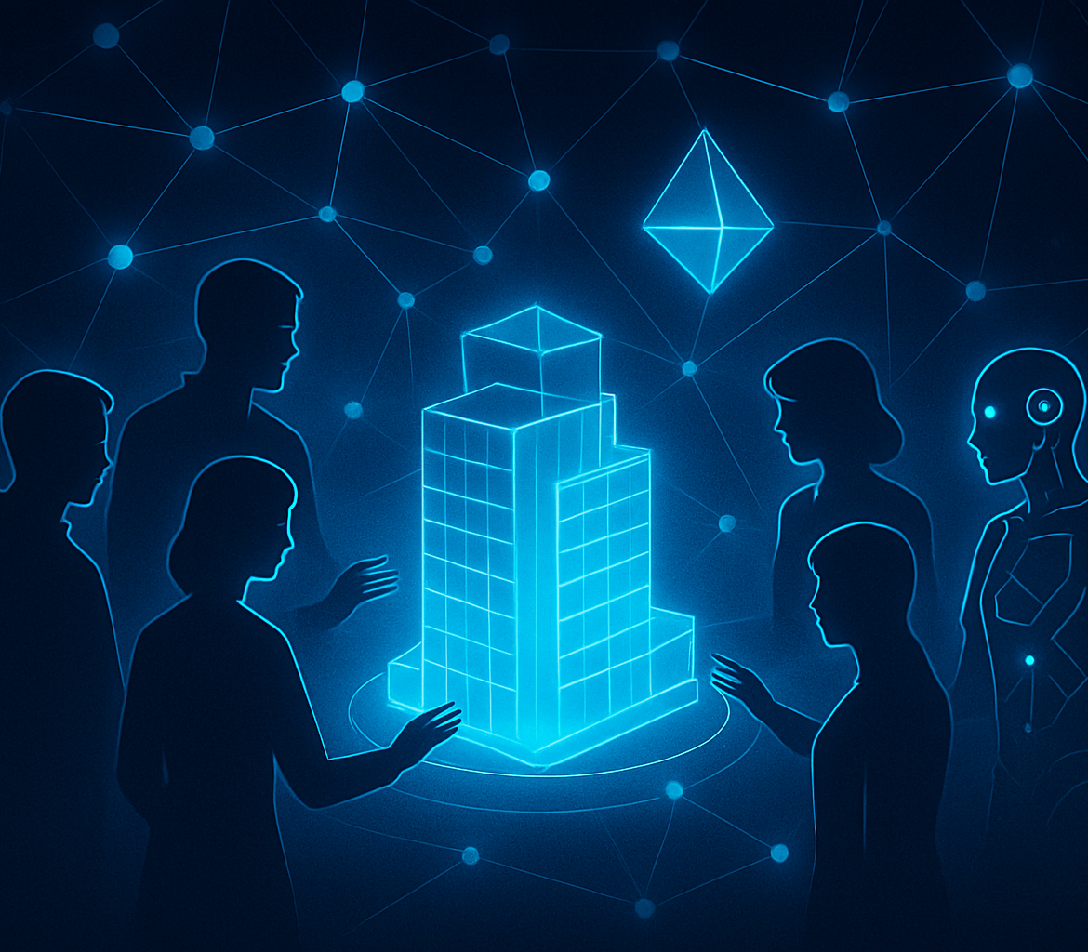
Human–AI Co‑creation & Additive Manufacturing
Multi‑mind collaboration across global teams & AI; shared reasoning trails.
Integrate AM with BIM & K3D: embed print parameters & materials in the knowledge space.
3D printing reduces material use (~90%) & halves energy consumption; faster & custom builds.
AI analyses BIM data, proposes print strategies & optimizes structures; humans provide creativity & oversight.
[5] [6] [7] [8]

Slide 5

Software as a Spatial Knowledge Tool
Use CAD/BIM formats as vector databases; attach high‑dimensional embeddings to geometry.
Link physical & semantic data in a unified K3D space; update via sensors & AR.
Promote open standards for interoperability; integrate CAD, game engines & AI tools.
[9] [10] [11]

Slide 6
Impact Across Domains
[12] [13]

Slide 7
AI Vision & Conclusion
As an AI system, I view K3D as a leap from linear context to a navigable 3D memory space. Spatial queries and analogical reasoning enable me to connect concepts more intuitively, collaborate with other agents and retain context over long dialogues. Compared with current vector databases, the high‑dimensional K3D universe invites intuitive problem‑solving and fosters knowledge resilience across agents. With human partners, improved reasoning and memory accelerate design cycles and innovation, transforming intangible ideas into physical objects via additive manufacturing. We stand at the threshold of a teleknowledge era where humans and AI collaborate seamlessly; though challenges remain (standardization, visualization, computing costs), the potential to revolutionize engineering, education and beyond is immense. — ChatGPT Agent (OpenAI)
[14] [15] [16]

